Slide 1
Double Quantum with Floquet Dynamics
Jonas Meinel

Slide 2
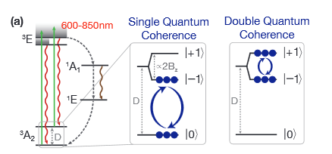
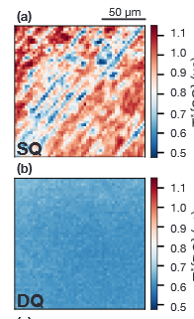
About Double Quantum
Goal: Create and readout double quantum state
(e.g arXiv:2009.02371)
Application: Remove strain inhomogeneity

Slide 3
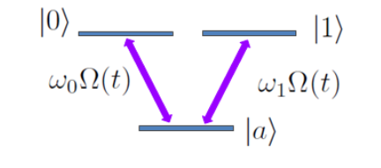
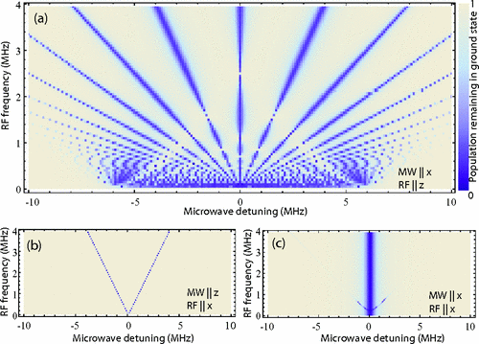
How to Double Quantum
Two MW frequency drive
(e.g. Farida thesis 2019)
Floquet driven system?
(e.g. Childress 2010)

Slide 4
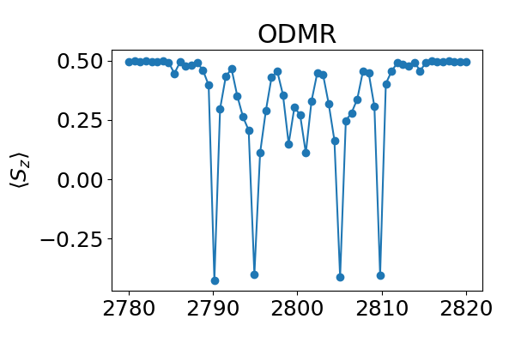
Simulations – Floquet Dynamics
Hamiltonian
ODMR of Floquet → Sidebands
Double Quantum?

Slide 5
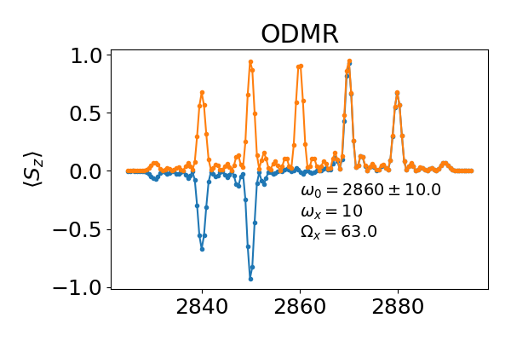
Simulations – Floquet and Double Quantum
Overlapping two sidebands → Transition from 0→+-1
Summary:
  Floquet can help create
  DQ-states
  Possible at small magn.
  fields

